Slide 1
Subsea Services Inc.
Website Development
Round 3 Comments
15 Sep 2016

Slide 2
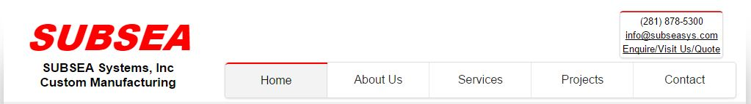
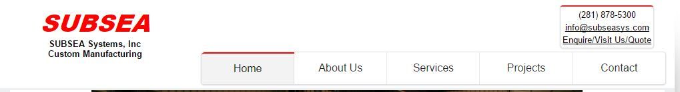
Website Name
The company name of the website needed to be changed as in GSY update.
Text | Font Type, Size (Medium) |  | Color
 | Maiku Update 6 | GSY Update
SUBSEA | Arial Black, Bold, CAPS, Italicized, 49 | Arial Black, Bold, CAPS, Italicized, 36 | Std. Red
SUBSEA Systems, Inc. | Arial, Bold, CAPS, -, 17 | Arial, Bold, CAPS, -, 13 | Std. Black
Custom Manufacturing | Arial, Bold, -, -, 17 | Arial, Bold, -, -, 13 | Std. Black
Maiku
GSY
Please update the company name as GSY Update

Slide 3
Enquiry Mail
Sorry we have given the mail id as info.subseasys.com
I have changed the code in to info@subseasys.com
Please follow the latest change.
The hyperlink of the enquiry mail is not working.
The latest website available in below location:
0119 Programming\Code\SSI Website\ssi-marketing(GSY-update)

Slide 4
Hyper Links at footer
Hyper links in below footer are NOT working on below screen shot. Please check?
The footer should read “A © 2016 SUBSEA Systems Inc.” Sorry! I missed plural for system. Please correct.

Slide 5
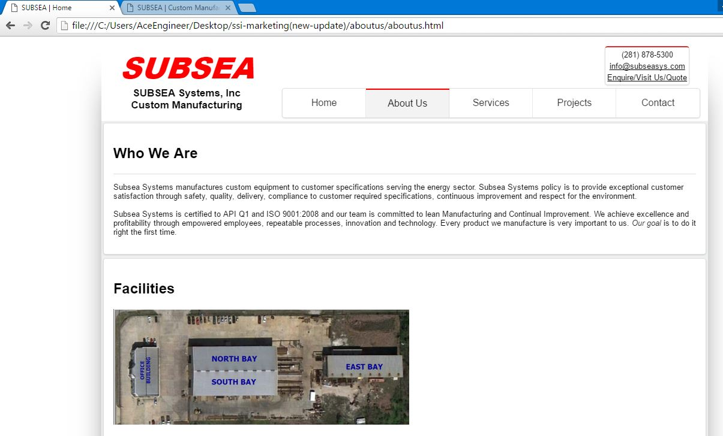
Tab Name
The name on the tab is always showing as “Subsea | Home” instead of showing “Subsea | About Us” when were are in about us page. This modification is to be implemented for all the pages.

Slide 6
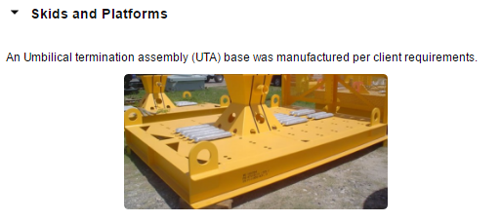
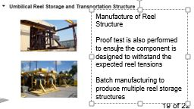
Project page Matter and Images
In projects page the images are having in 3rows and 4 columns and make change the images order in to 12 rows and 1 columns.
Please follow right hand side screen shot format.
Heading
Picture on left (60% width)
Text on right (40% width)
Heading
Picture on left (60% width)
Text on right (40% width)
Agree with more white space but the pictures need to be larger and this is the best way I can think of.
An Umbilical termination assembly (UTA) base was manufactured per client requirements.

Slide 7
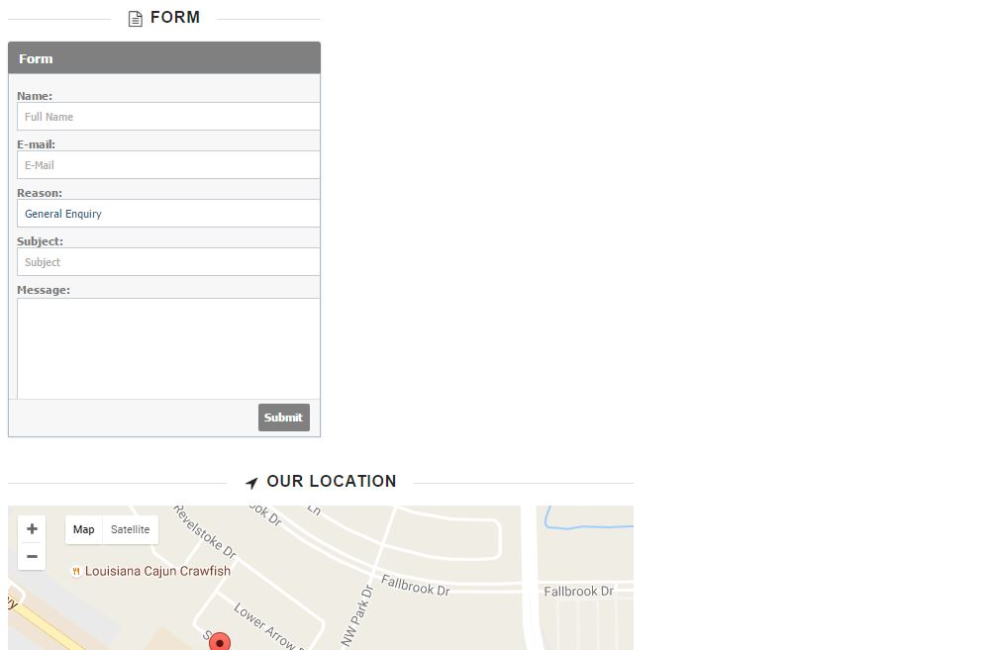
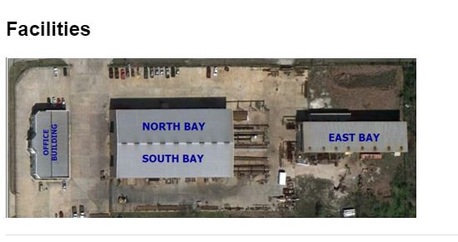
Headings
Please remove the external lines “Form” and “Our Location” and keep them simple (as shown in “Facilities”)

Slide 8
THANK YOU
For the opportunity to serve!

Slide 9
Document Revision History
01 | Round 2 comments. Round 1 comments in PRE-0006-01 | 12 Sept 2016 |  | GSY | VA
Rev | Description | Date |  | Author | Checked | Approved
Document No: |  |  | Client Ref:
0119-PRE-0007-01 |  |  | n/a

